Slide 1
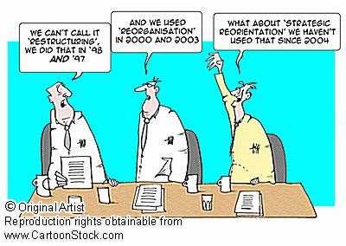
Edinburgh Business School MBA
AUC Academic Partner
Strategic Planning
Module 7
Making Choices among Strategies
Instructor: Moataz Darwish, MBA

Slide 2
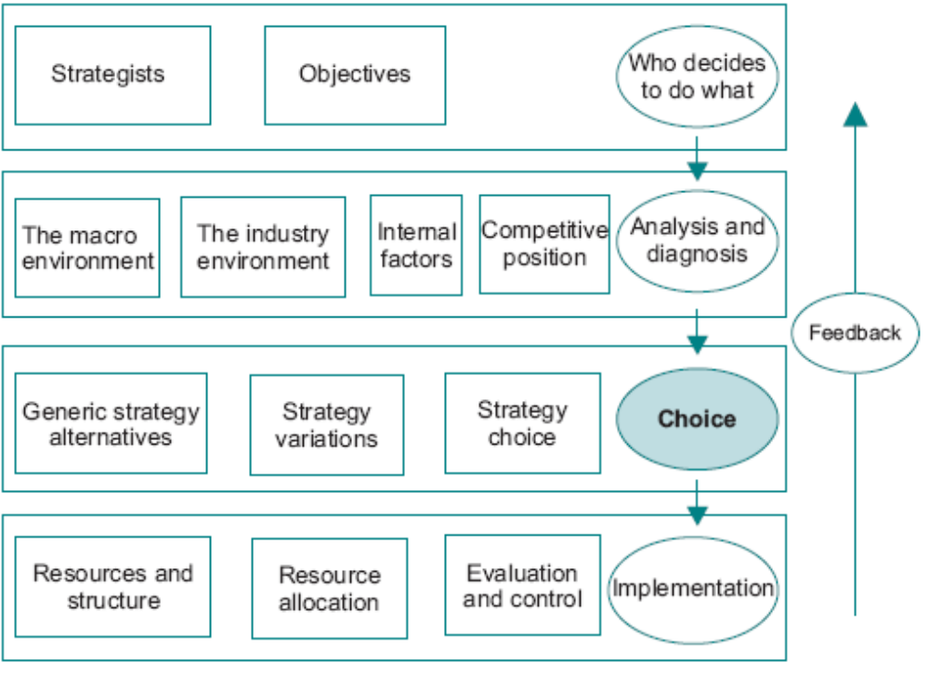
The Model
EBS MBA / AUC

Slide 3
Contents
A Structure for Rational Choice
Strengths, Weaknesses, Opportunities and Threats
Generic Strategies
Identifying Strategic Variations
Strategy Choice
EBS MBA / AUC

Slide 4
What is Strategy?
What is Strategy? Workshop – 30 mins
EBS MBA / AUC

Slide 5
A Structure for Rational Choice
Analyses of choice: investigate the structures within which choices are made among competing options.
Analysis:
  identify many relevant factors
  estimate their relative importance,
  thus providing the basis on which an informed choice can be made.
  BUT, NO course of action is generated yet.
EBS MBA / AUC

Slide 6
Contents
A Structure for Rational Choice
Strengths, Weaknesses, Opportunities and Threats
Generic Strategies
Identifying Strategic Variations
Strategy Choice
EBS MBA / AUC

Slide 7
Strengths, Weaknesses, Opportunities and Threats
ETOP & SAP can be combined together to identify where matches occur between the two → SWOT
SWOT analysis is an essential first step in:
  Assessing what the company needs to do to protect its current market position,
  And in identifying potential strategic thrusts which can capitalise on company strengths and market opportunities.
  It is not always a simple matter to categorise factors and recognise opportunities and threats for what they are;
  That is why it is so important to understand the core disciplines and be able to think through the implications of market information.
EBS MBA / AUC

Slide 8
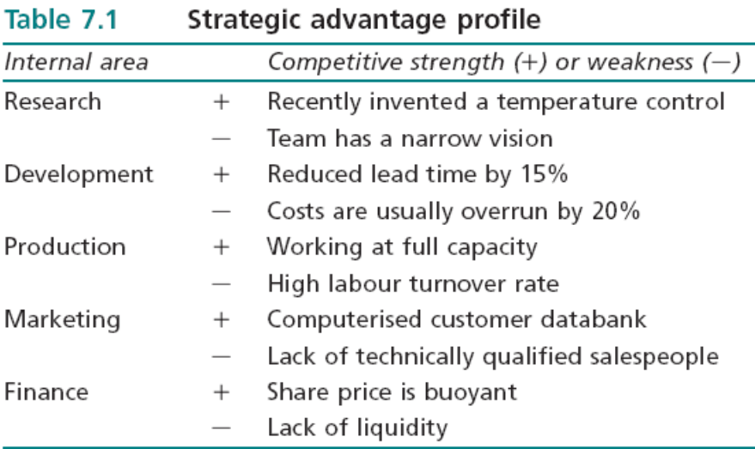
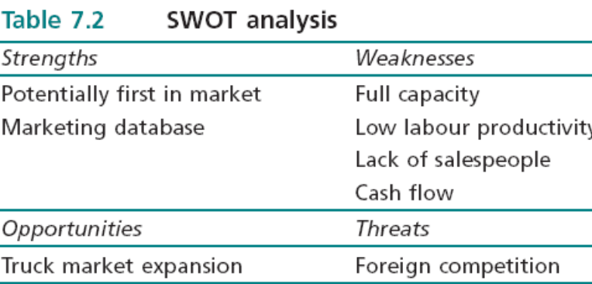
Strengths, Weaknesses, Opportunities and Threats
Government decision to reduce investment in railways and increase investment in the road network; one of the main markets for the new engine control is in very large trucks. A threat is the relaxation of trade barriers.
Strengths lie in what it might be able to do, and as a result these strengths do not match very well with the opportunity of expanding into the truck market.
Weaknesses relate to the company’s ability to bring the new product to the market, capture the new segment, and match aggressive foreign competition.
EBS MBA / AUC

Slide 9
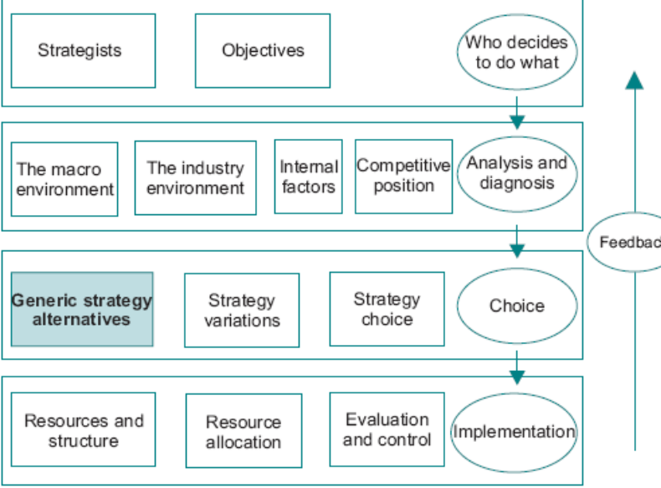
Contents
A Structure for Rational Choice
Strengths, Weaknesses, Opportunities and Threats
Generic Strategies
  Corporate Level Generic Options
  Business Level Generic Options
  Decision Maker Generic Strategies
  Generic Strategies and Company Performance
Identifying Strategic Variations
Strategy Choice
EBS MBA / AUC

Slide 10
Generic Strategies
Corporate Level Generic Options
  Scope of the company and the directions it will pursue, for example the development of new products or the acquisition of companies to increase the product portfolio.
  Mangers have to have: comprehensive analyses, explicit about which generic alternative they are pursuing and why.
  It is important to be clear about what the strategy options are NOT (ex. Expansion can not be defined as increase profitability) .
  The generic strategy is one of the means by which the end of profitability may be achieved.
2. Business Level Generic Options
  focus on effective exploitation of individual product markets, as opposed to the overall resource allocation problem facing corporate level strategists.
    Individual product OR strategy approach to group of products
Generic strategies are the basis on which the company attempts to build its competitive advantage; without a clear idea of the generic strategy which it is pursuing, a company is likely to end up with no identifiable strategy with the result that it will lack direction and strategic intent.
EBS MBA / AUC

Slide 11
Generic Strategies
Decision Maker Generic Strategies
Prospector
Analyzer
Defender
Reactor
Corporate Generic Strategies
Stability
Expansion
Retrenchment
Combinations
Business Level Generic Strategies
Cost Leadership
Differentiation
Focus
Stuck in the Middle
EBS MBA / AUC

Slide 12
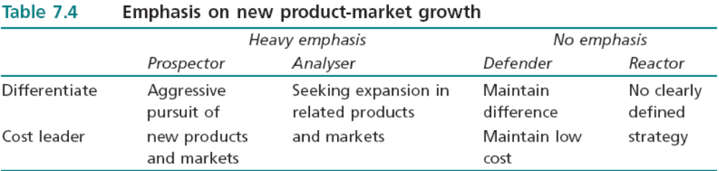
Generic Strategies
The approach to strategy is partly dependent on the overall or dominant characteristic of the decision maker or decision making group
Prospector: identification of new market opportunities
Analyser: sophisticated internal information systems and detailed investigation of options, but this is unlikely to be followed up by the type of action undertaken by the Prospector
Defender: maintaining the current market position without exhibiting a great deal of initiative in developing new market opportunities
Reactor: deals with circumstances as they arise
These dominant characteristics may be relevant only to a specific period, and will obviously change as managers are replaced.
Help towards understanding how the company has reached the position it is in, and the type of strategy which might win general support.
EBS MBA / AUC

Slide 13
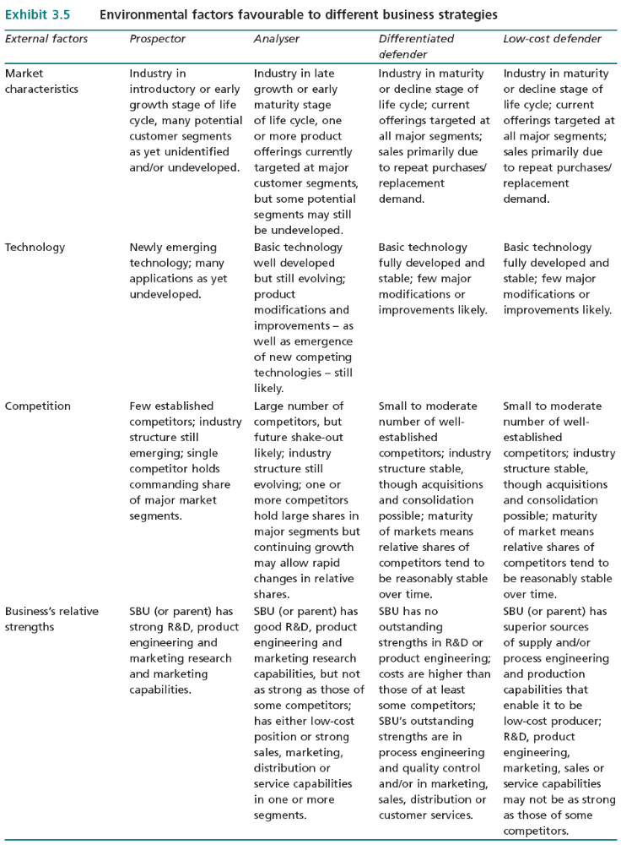
PLC
PEST
Market
Structure
Internal
Strength
EBS MBA / AUC

Slide 14
Generic Strategies
Corporate Generic Strategies
Stability
Expansion
Retrenchment
Combinations
Stay the same NOT steady
Expand
Get smaller
Change mix of activities
Relatively small performance gap
Markets are mature, long lifecycles
Internal weaknesses - aim to increase efficiency
Unstable financial history
Poor economic prospects, business cycle downturn
Competitive threat
Perceived costs of change – change averse
Managers averse to risk
Not trivial option – needs substantial internal changes
Diversifying risk
Searching for competencies or opportunities fit with it
Exploit Economies of scale / Experience effects
Building advance capacity (in recession)
Managerial motivation (remuneration/reward)
Re-structuring/ Down-sizing/ De-layering
End of Product life cycles
Dogs (divest)
Overextended markets (losing money on some markets)
Drive for efficiency
Either:
1-Diff strategies in diff SBUs (redeployment) OR
2-Sequentially
Opportunity cost
Product portfolio
Different generic strategies are appropriate in different circumstances.
What criteria to decide on? Depends on Co Objectives and adding most value to Shareholder wealth.
The distinction between means and ends must be maintained.
EBS MBA / AUC

Slide 15
Parenting Advantage (from Mod 1)
Stand-alone influence:
  the parenting activities include agreeing and monitoring performance targets, approving major capital expenditures and selecting business unit managing directors;
  the parenting influence may extend to product-market strategies, pricing and human resource management. But it can be argued that the more the parent extends its influence into the affairs of the individual businesses, the more likely it is that it will destroy value; this is the 10 per cent versus 100 per cent paradox: why should a parent manager working part time do better than a business manager working full time?
2. Linkage influence:
  the parent can encourage relationships to capitalise on synergy. But in the absence of a parent, business managers are free to establish linkages without parental involvement; so why should the parent do any better? This is the ‘enlightened self-interest’ paradox.
3. Functional and services influence:
  the parent can provide functional leadership and cost effective services. But this creates a supplier insulated from outside competition, and it is difficult to guarantee that internal suppliers will be as efficient as the market. This is the ‘beating the specialists’ paradox.
4. Corporate development activities:
  the main role of the parent is usually seen as buying and selling businesses, creating new businesses, and redefining businesses. This amounts to changing the businesses in the corporate portfolio. But since the weight of research indicates that the majority of corporately sponsored acquisitions, new ventures and business redefinitions fail to create value, the odds against success are long; this is the ‘beating the odds’ paradox.
EBS MBA / AUC

Slide 16
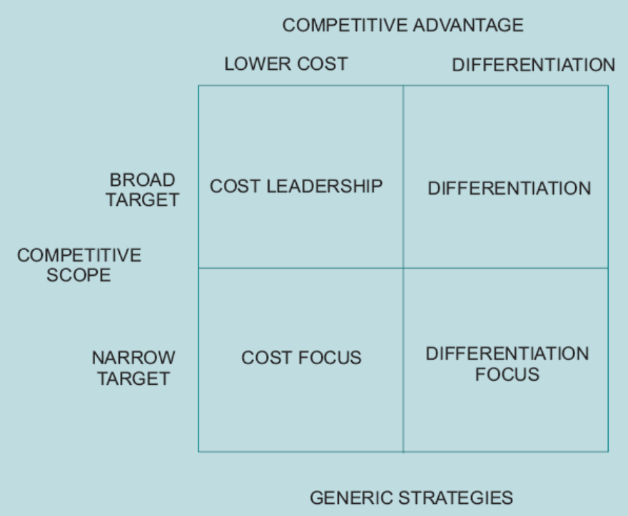
SBU Generic Strategies
Competitive Scope and Competitive Advantage:
  Company still has to make a decision between cost and differentiation even if it has identified a narrow target or niche.
  It follows that the skills required to pursue the different generic strategies are different.
  Switching from one generic to another has implications for the total design of the value chain.
Figure 7.2 Competitive scope and competitive advantage
EBS MBA / AUC

Slide 17
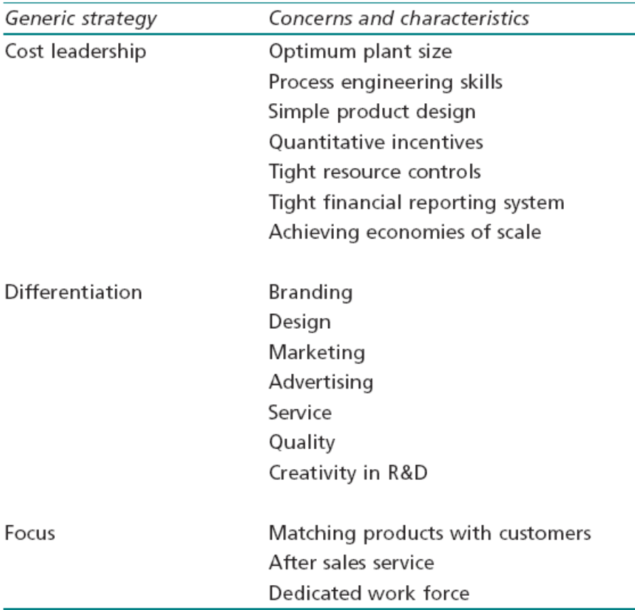
Generic Strategies
Cost Leadership – 2 preoccupations:
  Must achieve market share (high initial investment)
  Maintain efficient resource allocation, forefront of technology development to reduce cost, maintaining position.
Differentiation:
  Segmenting market with price premium to compensating for additional differentiation cost
  Irrational to ignore cost altogether
  Continually redefining the market
  Non-homogenous products with product position
Focus:
  Identify Market niches, avoid competition (product, process or consumer)
  Market share - irrelevant
Stuck in the middle:
  Undefined strategy, continually adjusting, confused
Table 7.3 Cost leadership, differentiation and focus: related activities
EBS MBA / AUC

Slide 18
Contents
A Structure for Rational Choice
Strengths, Weaknesses, Opportunities and Threats
Generic Strategies
Identifying Strategic Variations
Strategy Choice
EBS MBA / AUC

Slide 19
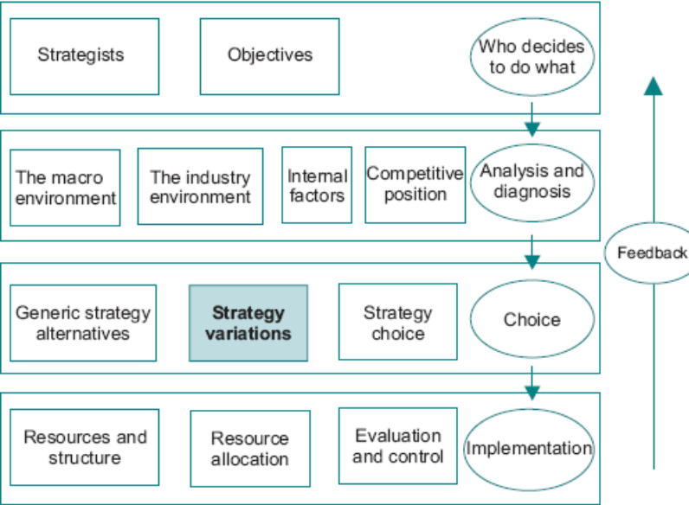
Identifying Strategic Variations
The next step is to identify which courses of action are available in order to achieve the identified objectives.
Within the context of a given generic strategy some broad classifications can serve to reduce the options which have to be evaluated.
EBS MBA / AUC

Slide 20
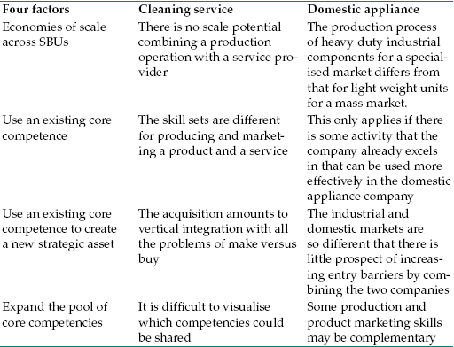
Identifying Strategic Variations
Related and Unrelated Diversification Options – relatedness
  Main incentives: minimise risk (mgt risk), capture economies of scope (could lead to diseconomies as well + dominant mgt logic), add value through the parenting, function and benefit from synergy.
To illustrate the benefits of not taking relatedness at its face value consider the case of a company that produces industrial office cleaning equipment.
Two options considered: to establish an SBU that undertakes office cleaning mainly using the company’s equipment or to invest in a production line producing domestic vacuum cleaners.
there is likely to be very little benefit from expansion in either case (little commonality between either routines or resources).
EBS MBA / AUC

Slide 21
Identifying Strategic Variations
2. Vertical Integration – backward (car company which takes over a steel rolling business)/ forward (ex. distributes its output or open retail outlet)
  ‘Make or Buy’ arguments of module 6 + unrelated diversification of past slide.
Acquisitions (external action) – reasons:
  Majority of acquisitions produces very little value, reasons include：
  Recognizing Unrealized Value – reasons include:
    Development expenditure has been inefficiently spent
    Marketing strategy has not pursued opportunities (segmentation or differentiation)
    Resource management has been poor (unit costs vs. similar companies)
    Expected increase in demand
    Weak products (several dogs)
  Buying Market Share (ex. Mature market)
  Reducing Competitive Pressures (vs. anti-trust laws)
  Synergy
  Balancing the Portfolio (strategic fit is crucial, importance of value added to be gained)
  Core Competencies – fit with strategic direction, complements the set of difficult-to-replicate skills, fits strategic architecture
EBS MBA / AUC

Slide 22
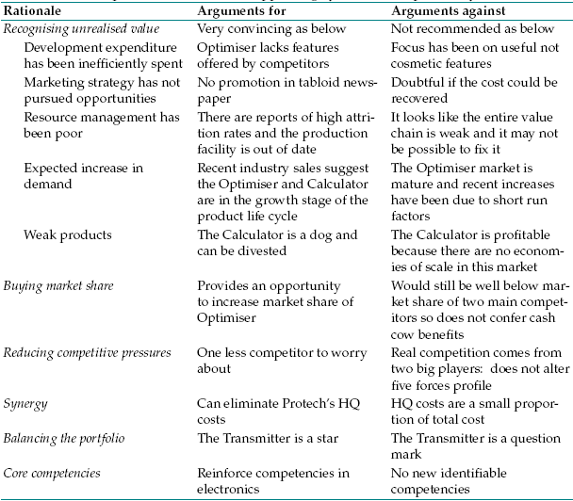
Justifying the Acquisition: Strategic Fit – Acme Co case
Acme, is a company that manufacturers a range of electronic gadgets and is considering the acquisition of Protech, a smaller rival that has a portfolio of three products: Optimiser, Calculator and Transmitter;
Acme’s portfolio already includes a version of the Optimiser but not the other two.
EBS MBA / AUC

Slide 23
Identifying Strategic Variations
Alliances and Joint Ventures - Arms-length contracts taking many forms, including:
  licensing agreements, franchise agreements, relational contracting, relational management, consortia, virtual corporations, virtual functions and joint ventures. It’s rational vs. mergers is key.
  Research has found no significant long-term effects of joint venture activity on profitability in any industrial sector. Reason s include:
    Prisoner’s dilemma: no contract can cover all eventualities and one side always has an incentive to cheat in some way
    collaborative ventures raise principal agent problems
International Expansion - focus on the elements of competitive advantage which can be transferred. Country specific or company specific determines whether to export or shift production (ex. Honda, Hong Kong Hotels).
  Challenges include:
  Volatile exchange rates present serious problems – hedging
  Relative factor costs and productivity (O/P per worker) vary by country.
  Governments often protect home production.
  Cultural norms
  Economies of different countries
EBS MBA / AUC

Slide 24
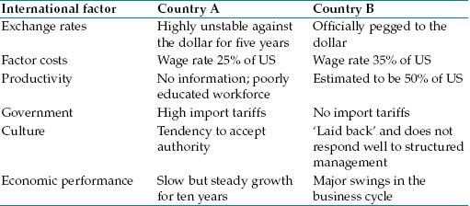
International expansion case
US based company that has decided it can transfer its competitive advantage to countries A and B and has to choose one of them.
The profiles of the two countries in terms of the international factors are as per the table.
There is clearly a lot that can go wrong so international expansion is often a high risk undertaking.
EBS MBA / AUC

Slide 25
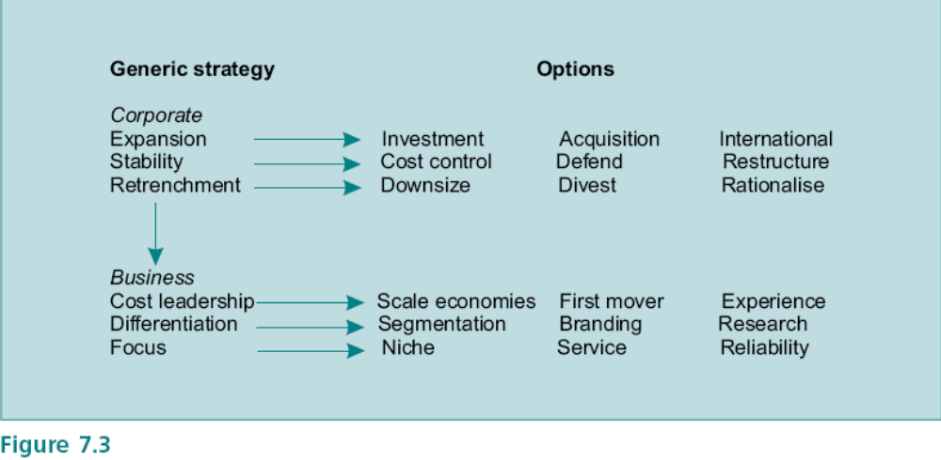
Identifying Strategic Variations
From Generics to Options
At the corporate level the generic strategy chosen requires the implementation of an option.
But at the same time these corporate choices must be underpinned by business level generic strategies.
The important issue is to recognise the need to align the different levels of strategy with appropriate options.
not mutually exclusive
logic of the choice process.
EBS MBA / AUC

Slide 26
strategic variation criteria
Consistency with objectives: For example, the objective may be to achieve market dominance in the domestic market, hence international expansion would not be consistent.
Suitability in terms of company resources: SWOT analysis is of crucial importance in determining suitability (alignment between company strengths and market opportunities). For example, a company may have a particular strength in cost control systems, but this may not fit with the market opportunities for differentiated products.
Feasibility: to some extent this is a matter of alignment, the commitment of key personnel must be obtained. Even if an option appears to be consistent and suitable, the intangible dimensions of organisational development may make it unworkable.
EBS MBA / AUC

Slide 27
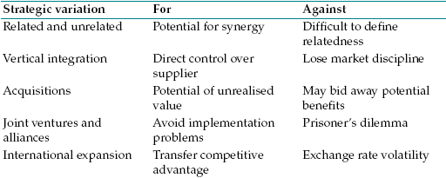
Machine Tool Business Case
Large cash reserve and the Board has decided on a corporate generic strategy of expansion.
strategic variations are consistent, suitable and feasible.
Which variation should be selected?
How do these variations compare with simply distributing the cash to shareholders in the form of dividends?
This depends on whether the
Board thinks it is possible to generate a better return for shareholders than they would have obtained elsewhere。
EBS MBA / AUC

Slide 28
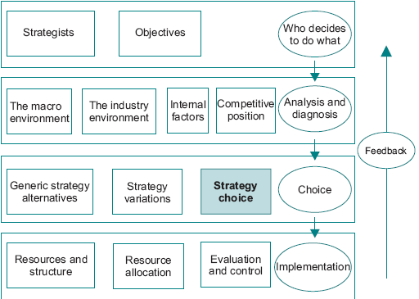
Contents
A Structure for Rational Choice
Strengths, Weaknesses, Opportunities and Threats
Generic Strategies
Identifying Strategic Variations
Strategy Choice
EBS MBA / AUC

Slide 29
Choice
Choice session
EBS MBA / AUC

Slide 30
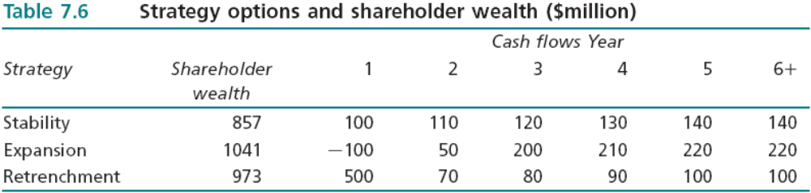
Strategy Choice
Shareholder Wealth
  Shareholder Wealth - the present value of the future cash flows expected to be generated by the company.
  Strategy Choice problem - identification and selection of the strategy option which maximises shareholder wealth.
  Many factors intervene which make the connection between proposed courses of action and the impact on shareholder wealth difficult to identify. Hence Shareholder wealth model can only be taken only as a starting point.
  Potential cash flows derived from analyses of markets, competition, opportunities, threats, environmental factors and so on.
EBS MBA / AUC

Slide 31
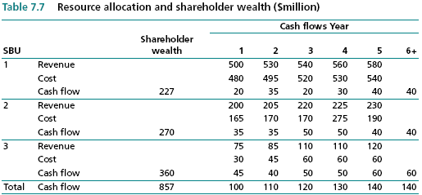
Strategy Choice
  A further powerful application of shareholder wealth analysis is to break down the activities of the company (or SBUs) and estimate the contribution which each makes to the total value of the company.
EBS MBA / AUC

Slide 32
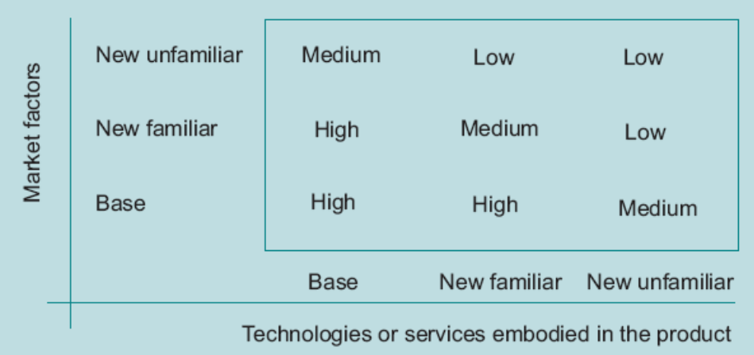
Strategy Choice
Performance Gaps
  In the example, the shareholder wealth analysis may advise several strategies which would accomplish the expansion option. The identification of the desired future state greatly narrows the range of feasible strategic options.
  The gap approach reduces the array of strategy alternatives to those which have direct relevance to the company’s objectives and to its potential capacity.
Corporate Management
  Portfolio of products – ex. BCG Matrix. Complicating factor is to make a strategic response to other companies which are developing their portfolios.
  Portfolio approach is a powerful tool in identifying areas which the company should be putting its resources. The weakness lies in identifying which products to put.
  The aim is thus to achieve a balanced but linked portfolio. One method of assessing the risks involved is the ‘Familiarity’ Matrix.
Figure 7.4 Familiarity matrix
New Product and New Entry (in Ansoff’s growth vector) suggesting Diversification might have significant difference in the degree of familiarity.
EBS MBA / AUC

Slide 33
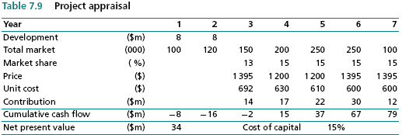
Strategy Choice
SBU Management
  Focus on exploitation of products and markets, and with ensuring that resources are allocated efficiently.
Using project analyses (project appraisal approach), and different scenarios by using sensitivity analysis (used in data-based cases comparing between products).
EBS MBA / AUC

Slide 34
Strategy Choice
Risk and Uncertainty Analysis
  managers are faced with the problem of making tradeoffs between the prospect of varying returns and possibilities of failure, possible outcomes and probabilities.
  attitude of managers to risk - risk aversion,
  uncertainty – unforeseen events, allowance to account for it.
  essential that strategies are constructed which have the potential to adapt to circumstances.
  contingency planning, which involves making sure that the strategy is capable of responding to a wide variety of scenarios, and keeping options open as long as possible.
EBS MBA / AUC

Slide 35
Strategy Choice
Managerial Perceptions - factors which bear on decision makers which might help to explain observed behavior:
  External Dependence – on customers, suppliers, majority shareholders.
  Attitudes to Risk – minimax criteria (lowest potential loss)
  Previous Strategies - success of the previous strategy may contain the seeds of future disaster
  Managerial Power Relationships – internal politics, principle agent problem,
  Consensus Decisions: The Paradox of Voting - voting is as subject to manipulation as any other decision technique, although it is less obvious to the participants.
EBS MBA / AUC

Slide 36
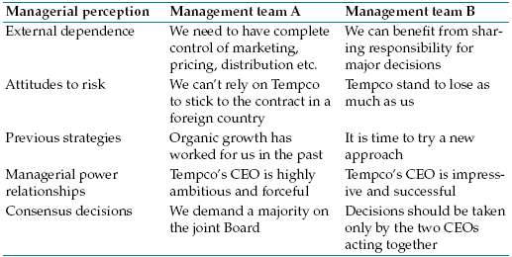
Alliance case
Consider the case of Acme that is considering entering into an alliance with Tempco to enter a foreign market.
The table shows how two different management teams might view the alliance purely on the basis of perception. This rather extreme example of perceptual differences demonstrates: why decisions are rarely taken purely on the basis of facts and rational discussion.
EBS MBA / AUC

Slide 37
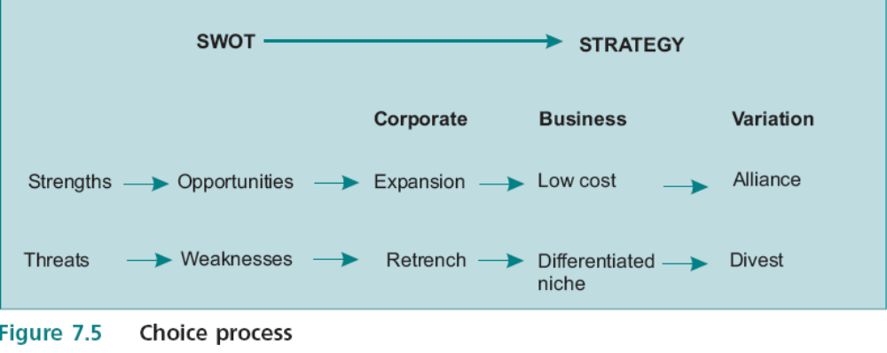
Strategy Choice
From SWOT to Generics
Identified the appropriate entries for each box in the SWOT matrix
Align strengths with opportunities and weaknesses with threats
Insights into the most appropriate corporate strategy, best business generic can be identified together with the strategy variation.
What happens if both of these are identified within the same SWOT analysis? That is when the CEO has some tough choices to make and really starts to earn her money. It is also an opportunity for inventive thinking.
EBS MBA / AUC

